Slide 1

News Automation: How RPA Bots Revolutionize Email Delivery – News hub
Team:
Gurparas Singh Dutta (2022A1R041)
Adheesh Chopra (2022A1r043)

Slide 2
Introduction
In this presentation, we will explore what RPA is, how it works, and its various applications.
We will discuss how RPA can be used to scrape news from different sites and automate news delivery to users via email.

Slide 3
Problem Statement
Difficulty and Time Consuming in knowing the Latest News of different jounra
Every time the bot will run, it will collect the data from internet, gather it on excel and then emailing it to the interested devotees.

Slide 4
Flowchart: Activities Used
Sequence
Open Browser
Data Scraping
Excel Application Scope
Send SMTP Mail Message
Write Range

Slide 5
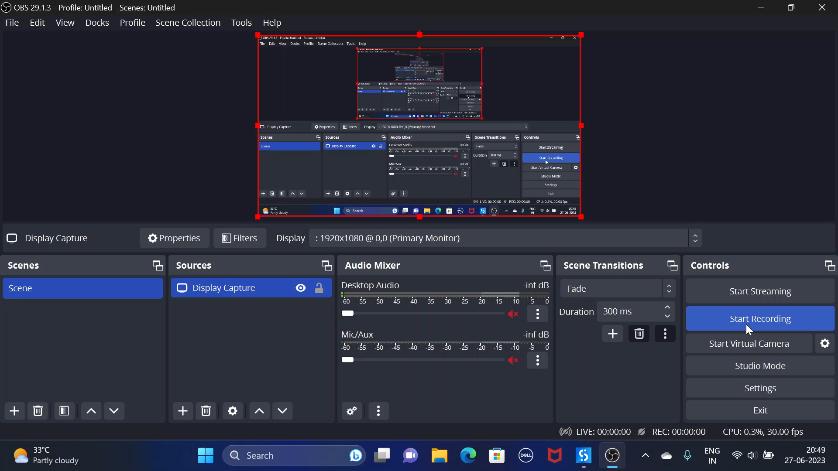

Slide 6
Conclusion
In conclusion, we have seen how RPA can revolutionize the way we work by automating mundane tasks and increasing efficiency. From scraping news to automating delivery, RPA has the potential to save time and resources while improving accuracy and quality.
As we move towards a more digital and automated future, it is important to embrace the possibilities of RPA and explore its potential applications in various industries. By doing so, we can unlock new opportunities for growth and innovation.

